Slide 1
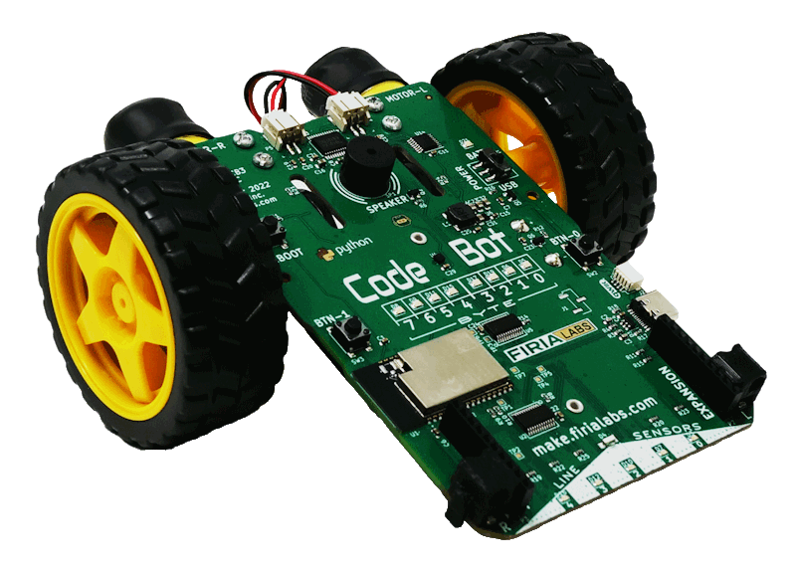
CodeBot Unit 3 Remix
Create your own project based on Missions 5 & 6

Slide 2

Time for a project remix!
A remix can be:
A new program created by adding new code to a program you already created
You can combine parts of two or more programs in a remix
Use a similar idea in a different way

Slide 3
Project Remix
Creating a remix will let you:
Improve your skills and practice the concepts from the mission.
Be creative.
Remember code from earlier programs and missions.
Work with other students.
Design an original program and write the code all on your own.

Slide 4
Step #1
Review Mission 5
Open your program from Mission 5
LineSense (fence patrol)
Review the mission logs from Mission 5
DO THIS:
Fill out the information in the Planning Guide for Step 1

Slide 5
Step #1
Review Mission 6
Open your programs from Mission 6
CheckLines
LineFollow
Review the mission logs from Mission 6
DO THIS:
Fill out the information in the Planning Guide for Step 1

Slide 6
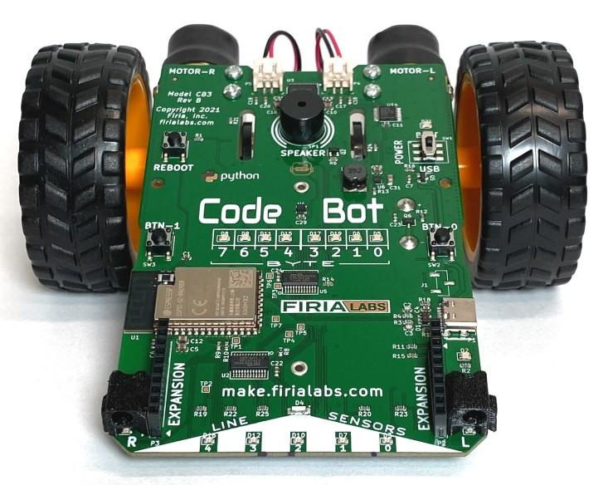
Step #2
Brainstorm ideas
For this project, you will decide what CodeBot will do.
While you were working on the programs for these missions, did you ever have your own ideas, or wonder “what if”?
If so, this is your chance!
If you already have your own idea, you are good to go.
If not, read some of the suggestions on the next slide. You can use one of them, or use them as inspiration for your own idea.

Slide 7
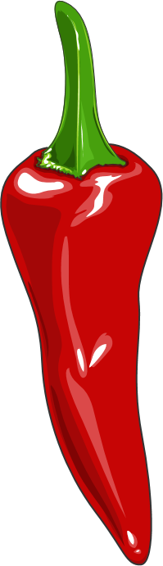
Step #2 Remix Ideas
Mild
Create a line following or fence patrol program. Add flashing lights and beeps for specific movements.
Mild
Create a fence patrol program that counts each time it hits a line. Then after five hits, the ‘bot does a little animation with spins, lights and beeps.

Slide 8
Step #2 Remix Ideas
Medium
Create a line following program that counts laps. One way to do this is to add a different color tape at one place, that will have a different line sensor reading (but still above threshold). When the line sensors read the colored tape, it counts a lap.
Medium
Combine the line follower program with the fence patrol program. Push button 0 for one of the programs, and button 1 for the other program.

Slide 9
Step #2 Remix Ideas
Spicy
Create an animation, like Mission 4. For part of the animation, follow a line. Then transition to a different animation that stays within a border, like on a stage.
Spicy
Work with a partner and a second CodeBot to synchronize a dance. Sometimes the ‘bots will do partner work together, and sometimes each will have a solo. They need to stay on the dance floor in bounds at all times.

Slide 10
Step #2
Brainstorm ideas
Read through remix suggestions.
Use the suggestions –or–
Use your creativity to come up with your own idea for a project.
Decide what project you will do.
DO THIS:
Fill out the information in the Planning Guide for Step #2

Slide 11
Step #3
Make a plan
Write an algorithm for your project.
Think about the tasks for the program.
Think about the steps it will take to complete the tasks.
Make a step-by-step plan.
What happens first?
What happens next?
What happens with each button press?
DO THIS:
Fill out the information in the Planning Guide for Step #3

Slide 12

Step #4
Code your project
IMPORTANT: In CodeSpace, go to the sandbox
Start a new file and give it a descriptive name (Remix3)
You can leave other programs open and use them as a guide
Import your libraries
Define your variables
Write your code a little bit at a time, testing frequently (divide and conquer!)

Slide 13
Step #4
Stop and test frequently!
Don’t try to write all the code at one time
Think about the steps:
Just get one thing to work, then move on
Step by step!
Mistakes happen, so find them early
Type just a few lines of code and then run the program
If there is an error, fix it before continuing
Use your other programs and classmates for help

Slide 14
Step #4
Documentation!
Make sure your code is readable by adding blank lines
Add comments to sections of your code that explain what they do

Slide 15
Step #5
Get feedback and Revise
Show your code to other students.
What do they think? Have them fill out the feedback form on your Planning Guide.
The Planning Guide has space for two people to give feedback. The feedback can come from two peers or one peer and yourself.
Use the peer reviews to modify your code and make your project even better

Slide 16

And now you have your own remix!
Congratulations!
By completing this remix you have:
learned more about programming
practiced the skills and concepts from the missions
been thinking! And problem solving and much more!

Slide 17
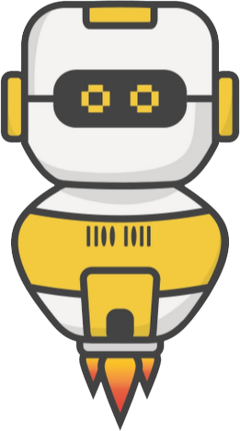
Mission Reflection
Wow! Great job!
Share your project with your friends!
Run projects from other students
Complete the Post-Remix Reflection in the Planning Guide

